Slide 1


시각 Tech. 심화과정 (2) Lab session
연세대학교 컴퓨터과학과
남 성 현

Slide 2
Contents
Style transfer
Content loss
Style loss
Total-variation regularization
Super-Resolution
SRCNN / VDSR
Loss functions: MSE, MAE, Huber
Sub-pixel convolution

Slide 3
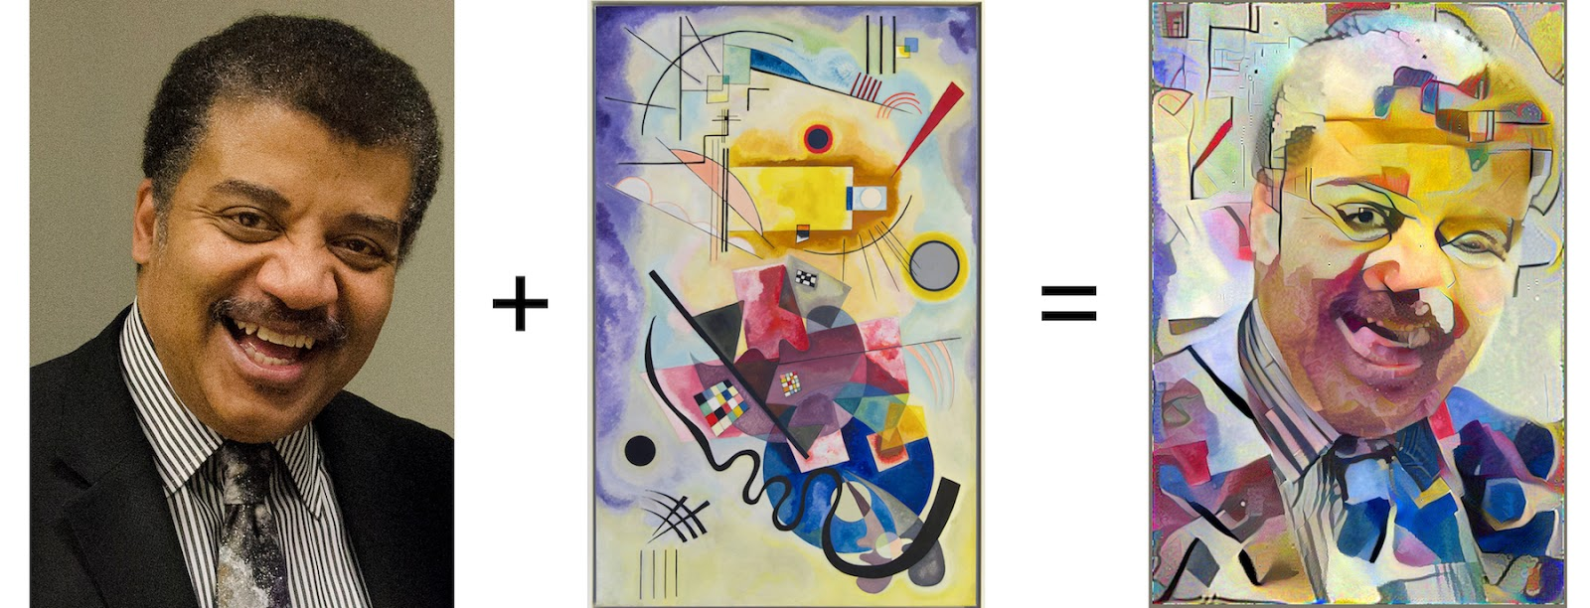
Style Transfer
Take two images, and produce a new image that reflects the content of one but the artistic style of the other

Slide 4
Style Transfer
Gatys, Leon A., Alexander S. Ecker, and Matthias Bethge. "Image style transfer using convolutional neural networks." Proceedings of the IEEE Conference on Computer Vision and Pattern Recognition. 2016.

Slide 5
Style Transfer
Content loss
Gatys, Leon A., Alexander S. Ecker, and Matthias Bethge. "Image style transfer using convolutional neural networks." Proceedings of the IEEE Conference on Computer Vision and Pattern Recognition. 2016.

Slide 6
Style loss
Gatys, Leon A., Alexander S. Ecker, and Matthias Bethge. "Image style transfer using convolutional neural networks." Proceedings of the IEEE Conference on Computer Vision and Pattern Recognition. 2016.

Slide 7
Style Transfer
Implementation: ./StyleTransfer/
Define loss functions in stylize.py Content loss Style loss TV-reg Total loss

Slide 8

Content loss
Content loss measures how much the feature map of the generated image differs from the feature map of the source image
the feature map for the current image
the feature map for the content source image
the weight of the content loss

Slide 9
Style Transfer
Content loss
Gatys, Leon A., Alexander S. Ecker, and Matthias Bethge. "Image style transfer using convolutional neural networks." Proceedings of the IEEE Conference on Computer Vision and Pattern Recognition. 2016.

Slide 10
Style loss
First, compute the Gram matrix G which represents the correlations between the responses of each filter, where F is as above

Slide 11
Style loss
Gatys, Leon A., Alexander S. Ecker, and Matthias Bethge. "Image style transfer using convolutional neural networks." Proceedings of the IEEE Conference on Computer Vision and Pattern Recognition. 2016.

Slide 12
Total-variation Regularization
Helpful to encourage smoothness in the image
You can compute the "total variation" as the sum of the squares of differences in the pixel values for all pairs of pixels that are next to each other (horizontally or vertically)
Here we sum the total-variation regularization for each of the 3 input channels (RGB)

Slide 13
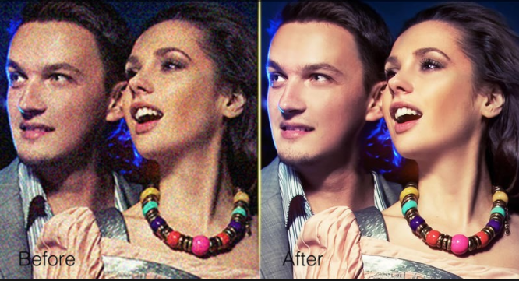
Total-variation Regularization

Slide 14
Style Transfer
Result
python neural_style.py –content <content file> --styles <style file> --output <output file>
https://github.com/anishathalye/neural-style

Slide 15
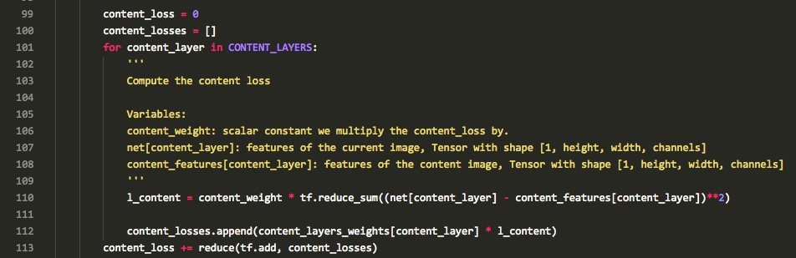
stylize.py
https://github.com/anishathalye/neural-style

Slide 16
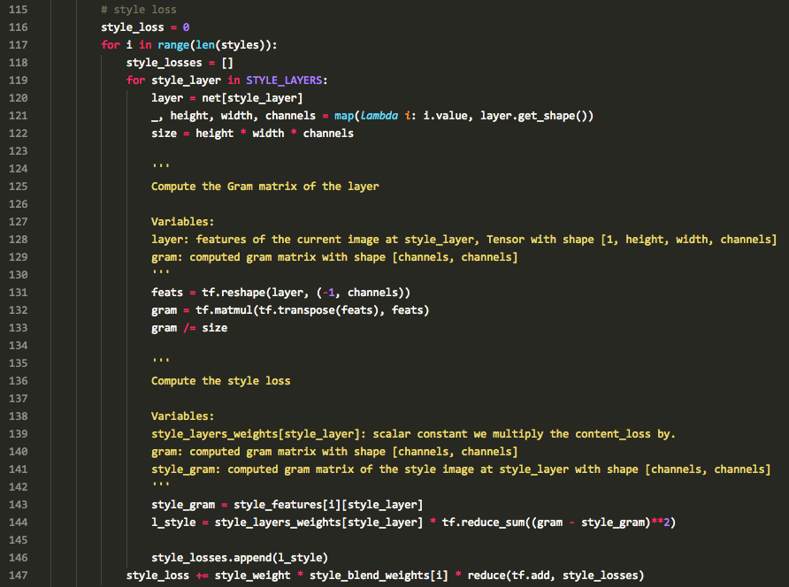
stylize.py
https://github.com/anishathalye/neural-style

Slide 17
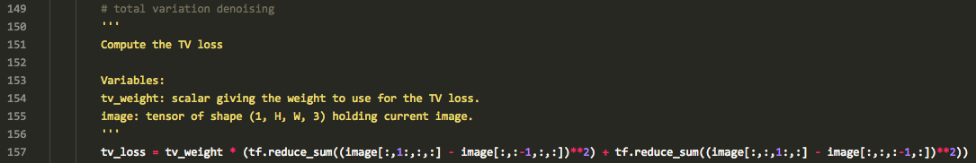
stylize.py
https://github.com/anishathalye/neural-style

Slide 18
SRCNN
Early work using CNN to image super-resolution
http://mmlab.ie.cuhk.edu.hk/projects/SRCNN.html

Slide 19
SRCNN
Implementation: ./SR/srcnn.py
32x32, 24,800 training samples from 91 images
using Y channel only (rather than RGB) Human eye is sensitive to brightness than color
No padding
ReLU
Initialized by random Gaussian mean=0, stddev=0.001, bias=0
Learning rate (first two: 0.0001, last: 0.00001)
MSE loss function
J. Yang, J. Wright, T. S. Huang, and Y. Ma. Image superresolution via sparse representation. TIP, 2010.

Slide 20
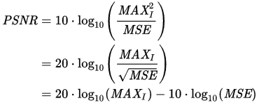
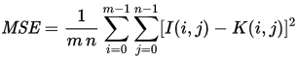
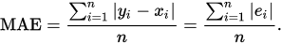
Peak Signal-to-Noise ratio
PSNR
신호가 가질 수 있는 최대 전력에 대한 잡음의 전력
화질 손실 정보를 평가할때 사용
MSE
MAE
tf.reduce_mean(tf.square(x - y))
tf.reduce_mean(tf.abs(x - y))
J. Yang, J. Wright, T. S. Huang, and Y. Ma. Image superresolution via sparse representation. TIP, 2010.

Slide 21
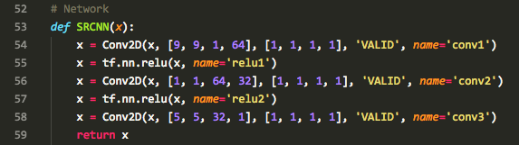

srcnn.py

Slide 22
VDSR
Very deep CNN for SR
http://cv.snu.ac.kr/research/VDSR/

Slide 23
VDSR
Implementation: ./SR/vdsr.py
41x41, 7,968 training samples from 291 images
using Y channel only (rather than RGB) Human eye is sensitive to brightness than color
ReLU
Momentum 0.9 / Weight decay 0.0001
High learning rate 0.1 decreased by 10 every 20 epochs
He initialization
MSE loss function
Gradient clipping / Multi-scale
J. Yang, J. Wright, T. S. Huang, and Y. Ma. Image superresolution via sparse representation. TIP, 2010.

Slide 24
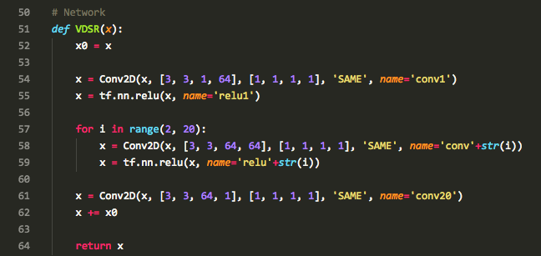
vdsr.py

Slide 25
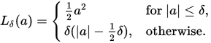
Huber loss
Quadratic for small values of a, and linear for large values
MSE와 MAE의 장점을 모두 가짐

Slide 26
Sub-pixel Convolution
A sub-pixel convolution layer that aggregates the feature maps from LR space and builds the SR image in a single step

Slide 27
VDSR with sub-pixel conv
Implementation: ./SR/vdsr_sp.py
Conv → tf.depth_to_space
Shi, Wenzhe, et al. "Real-time single image and video super-resolution using an efficient sub-pixel convolutional neural network." Proceedings of the IEEE Conference on Computer Vision and Pattern Recognition. 2016.

